Slide 1
Supercharge your Database Management with DbaTools
Your “new” Super Power
Patrick Flynn
The Link Group

Slide 2




Patrick Flynn SQL Server DBA Link Group Australia Group
MCM – SQL Server 2008
MCSM – Data Platform
Production DBA for 10+ years.
Regular Speaker at SQL Saturday and other community events in Asia Pacific region
All Presentations available at:
https://github.com/sqllensman/Presentations
dps2018@sqllensman.com
@sqllensman
Patrick Flynn

Slide 3
Agenda
PowerShell – Quick Recap
dbatools.io
Demos

Slide 4

Why powerSHELL?

Slide 5
DBATOOLS.io

Slide 6

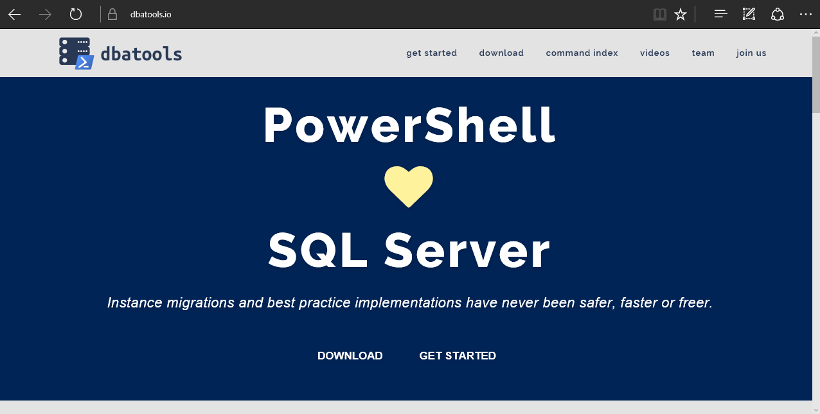
dbatools
Notes:
Community project, initially started out as Start-SqlMigration but has grown into a DBA’s best friend. dbatools currently sports 400+ commands.
How many of you have heard of dbatools? How many of you have used it? How many knew it was born in Belgium? :D

Slide 7
Requirements
Minimum
Client
PowerShell v3
SQL Server Management Studio / SMO 2008 R2
Server
SQL Server 2000
No PowerShell for pure SQL commands
PowerShell v2 for Windows commands
Remote PowerShell enabled for Windows commands
Recommended
Client
PowerShell v5.1

Slide 8
Installation
PowerShell Gallery (PowerShell v5+)
Install-Module dbatools
Install-Module dbatools –Scope CurrentUser
GitHub – dbatools.io/git
Invoke-Expression (Invoke-WebRequest https://dbatools.io/in)
Clone repo found at dbatools.io/git, Import-Module dbatools

Slide 9


Slide 10
Asking Questions via Slack
Go to sqlslack.com to get an automatic invite.
Sign in at sqlcommunity.slack.com
Join the #powershellhelp channel.
Also a dedicated #dbatools
Ask questions! ( people are friendly ☺ )
Further information: dbatools.io/slack/

Slide 11
Questions?
?
?
?
?
?
?
?
?
?
?
?
?
?
?
?
?

Slide 12
More Help
Extensive documentation within each command Get-Help Start-DbaMigration –Detailed
Extensive documentation on dbatools.io
dbatools.io/Start-DbaMigration
dbatools.io/Repair-DbaOrphanUser
Some commands have videos
dbatools.io/youtube

Slide 13
Powershell Resources
PowerShell for SQL Data Professionals
https://mva.microsoft.com/en-US/training-courses/powershell-for-sql-data-professionals-16532?l=XgA5w0PgC_8805121157
PASS Powershell Virtual Chapter
http://powershell.sqlpass.org/
PASS Recordings
http://www.pass.org/Learning/Recordings/Listing.aspx?category=webinars24Hours
Manage SQL Server in Linux Containers using dbatools

Slide 15
Post your pics with hash tag #DPS10 and win some cool prizes
Join DataPlatformGeeks community. www.DataPlatformGeeks.com

